Slide 1
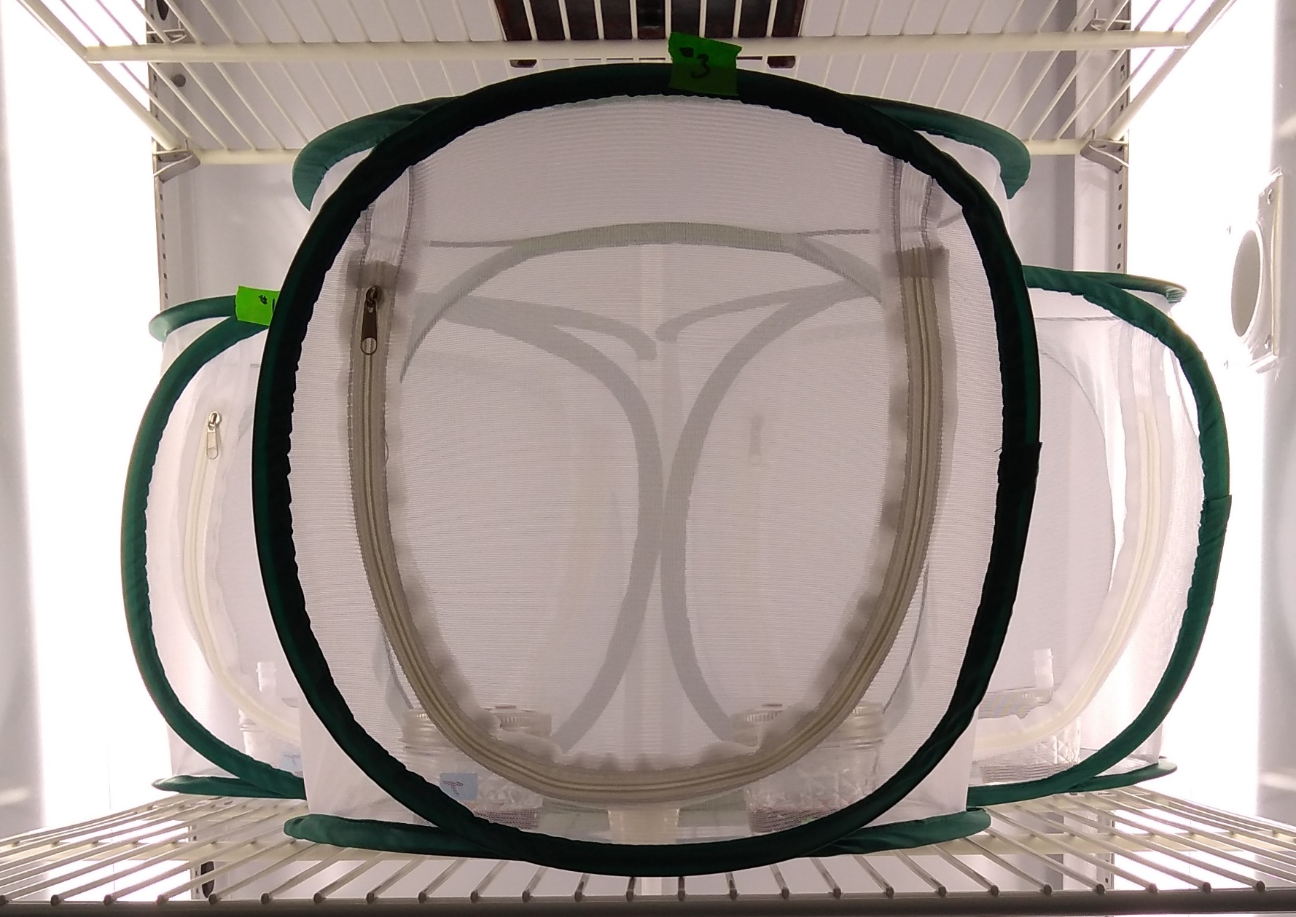
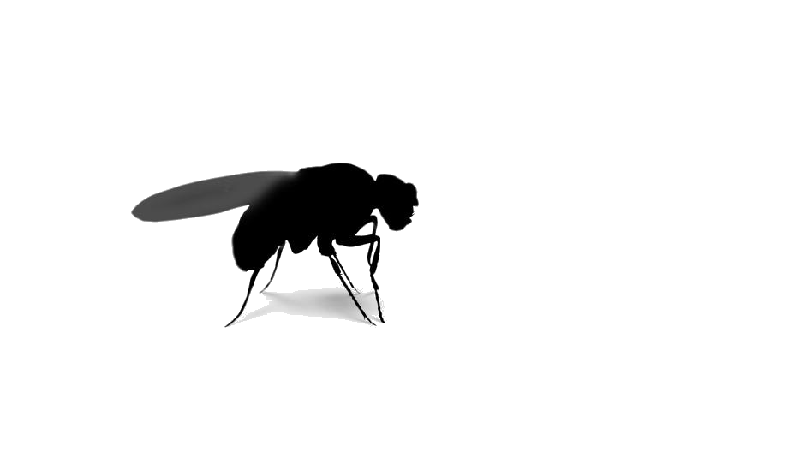
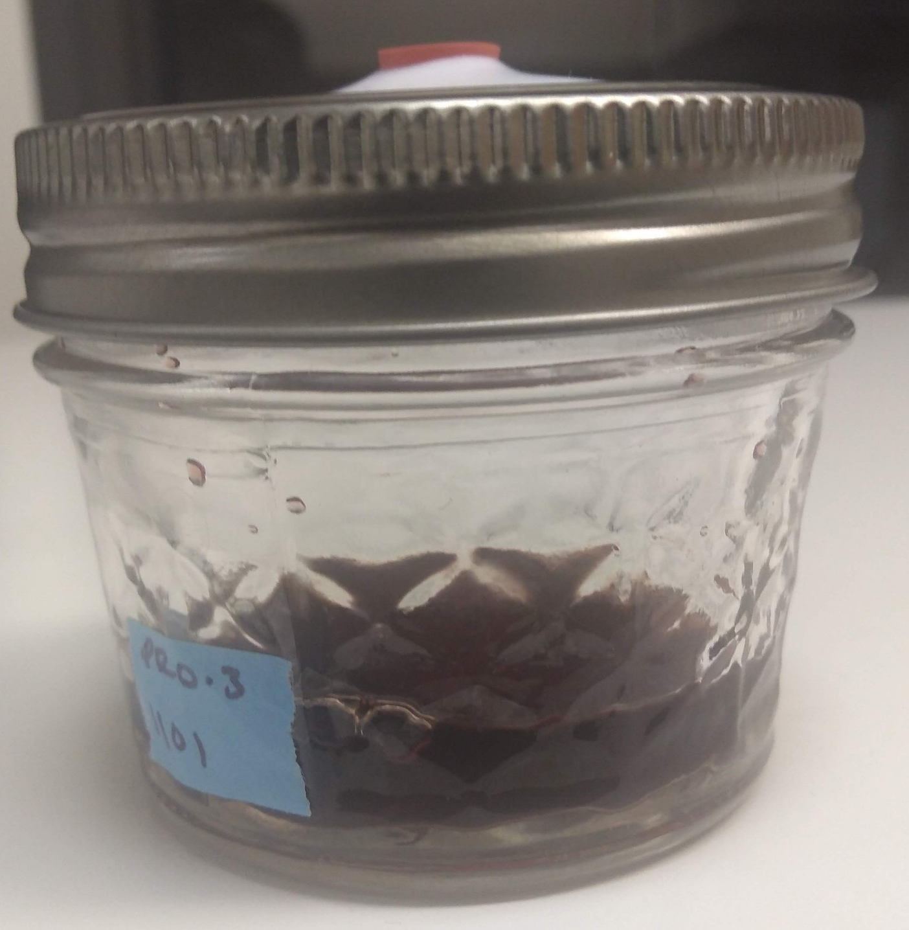
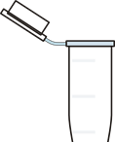
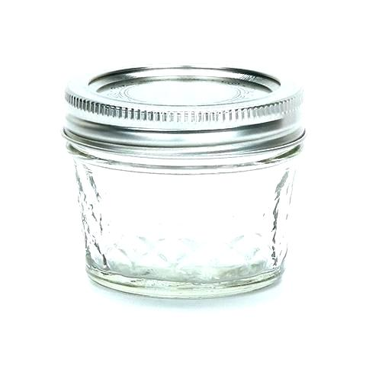
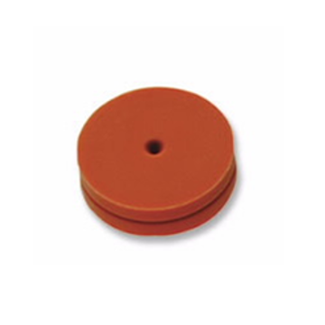
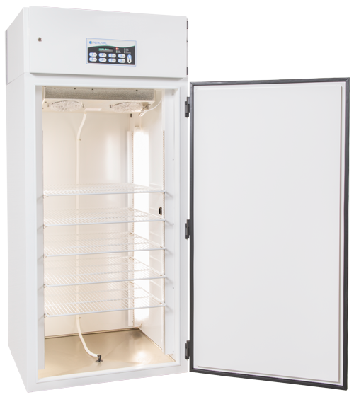
Equipment
Mesh Cages
Trap Jars
4 oz ball jar
Metal lid ring
Teflon lid cover with 2 holes
1 septa covered hole
1 hole plugged with a centrifuge tube
Incubators
25 C, 60% rH, and 16:8 L:D

Slide 2
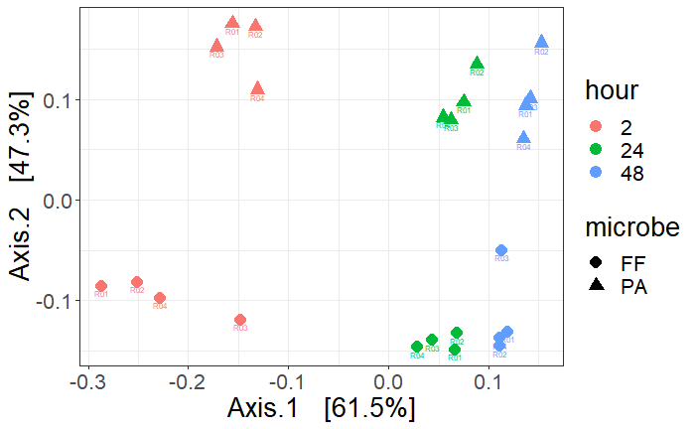
Multidimensional scaling (MDS) using principal coordinates analysis (PCoA) of a Bray-Curtis distance matrix comparing the volatile composition between Frigoribacterium faeni and Pantoea agglormerans. Microbes were inoculated into liquid LB broth and 10% blueberry juice and each solution contained only one microbe species. Marker shapes represent the microbes and colors represent the hour when volatiles were collected. Axis.1 explained 61.5% of the variance and Axis.2 explained 47.3% of the variance.

Slide 3
F. faeni target VOCs
P. agglomerans target VOCs
Carbonic acid, dimethyl ester
2-Nonanone
Benzene, 1,3-bis(1,1-dimethylethyl)-
Pyrazine, 3-ethyl-2,5-dimethyl-
Bicyclo[2.2.1]heptan-2-ol, 1,7,7-trimethyl-, (1S-endo)-
1-Propanol, 3-(methylthio)-
(-)-Myrtenol
3-Cyclohexene-1-ethanol, .beta.,4-dimethyl-
p-Mentha-1(7),8(10)-dien-9-ol
Eugenol
Disulfide, dimethyl
1-Butanol, 3-methyl-, acetate
Heptanal
2-Hexenal, (E)-
Acetoin
1-Heptanol
Furfural
1-Hexanol, 2-ethyl-
Benzonitrile
2-Furanmethanol
Mequinol
2H-Pyran-2-carboxaldehyde, 5,6-dihydro-
Phenol

Slide 5
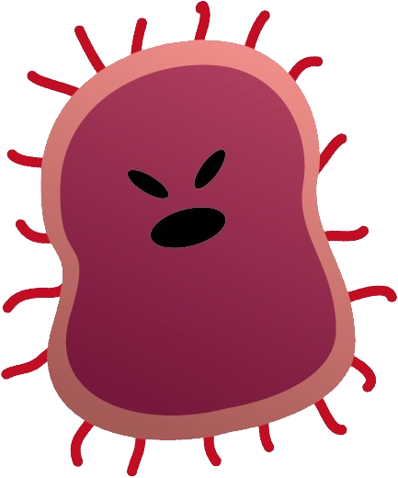
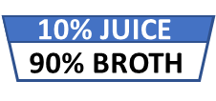
What is in a name?
Blank
Control
Treatment
1 mesh cage
2 empty trap jars
1 mesh cage
2 trap jars
10% juice
90% culture broth
1 mesh cage
2 trap jars
10% juice
90% culture broth
Microbes
10% JUICE
90% BROTH
10% JUICE
90% BROTH

Slide 6
Drawing Comparisons Between Micorbe VOCs and SWD Behavior
Microbe VOCs collected from:
F. faeni in 10% juice
P. agglormeans in 10% juice
F. faeni and P. agglormeans mixed together in 10% juice (both at same relative initial conc/amount)
SWD Choice Background Testing
(R-C0621) Intermittent F. faeni in 10% juice vs. 10% juice (One 48H trials)
(R-C0621) F. faeni in 10% juice vs. 10% juice (Two 24H trials)
(A-C0633) P. agglormeans in 10% juice vs. 10% juice (Two 24H Trial)
SWD Choice Bioassay
(R-C0621) F. faeni in 10% juice vs. 10% juice (7 Treat | 1 Control)
(A-C0633) P. agglormeans in 10% juice vs. 10% juice (7 Treat | 1 Control)
F. faeni in 10% juice vs. P. agglormeans in 10% juice (7 Treat | 1 Control)
F. faeni + P. agglormeans in 10% juice vs. F. faeni in 10% juice together in 10% juice.
This brings up next questions as to mechanism (pop, priority, metabolites, host, or other)

Slide 7
SWD Choice Bioassay: Microbe vs. Control
VS.
Standard Conditions
Environment: 22 C, 40% rH, 16L:8D photoperiod
50 flies removed from food source ~20 hours prior to treatment
Microbe Inoculated: Time zero.
Flies Infused: Time zero
Fly Observed: 24 hours after time zero.
VOCs will be sampled from a single cage containing samples jars but no flies
F. faeni
VS.
P. agglomerans
VS.
F. faeni
P. agglomerans

Slide 8
Experimental Weeks: 1, 2, & 3
SWD Choice: Microbe vs Control
Frigoribacterium faeni
Pantoe agglomerans
1x
5 Cages Total:
1 Control Cage
1 Control Jar: 10% Juice
1 Treatment Jar: 10% Juice + Microbe
NO Flies
Treatment Cages
1 Control Jar: 10% Juice
1 Treatment Jar: 10% Juice + Microbe
50 SWD flies
1x
5 Cages Total:
1 Control Cage
1 Control Jar: 10% Juice
1 Treatment Jar: 10% Juice + Microbe
NO Flies
Treatment Cages
1 Control Jar: 10% Juice
1 Treatment Jar: 10% Juice + Microbe
50 SWD flies
7x
7x

Slide 9
Protocol
Environment: 22 C, 40% rH, 16L:8D photoperiod
50 flies per each chamber will be removed from food source ~20 hours prior to entering the treatment arenas and provided only water.
Microbes will be cultured 20 to 24 hours prior to inoculation.
Microbes will be inoculated into treatment at time zero.
Flies will be added to treatment arenas at time zero
Fly choice will be counted 24 hours after time zero.

Slide 10
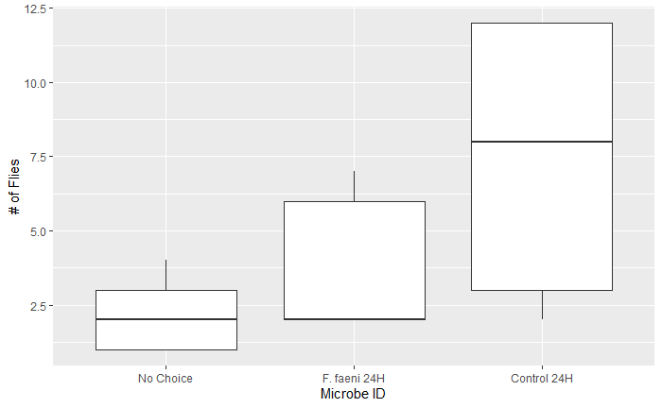
USDA STARVED FLIES
2

Slide 11
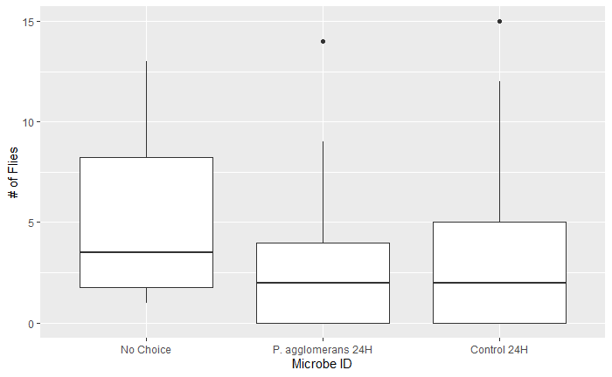
USDA STARVED FLIES

Slide 12
UF Assay Results
Environment:
40 flies per each chamber will be removed from food source ~20 hours prior to entering the treatment arenas and provided only water.
Microbes will be cultured 20 to 24 hours prior to inoculation.
Microbes will be inoculated into treatment at time zero.
Flies will be added to treatment arenas at time zero
Fly choice will be counted 72 hours after time zero.

Slide 13
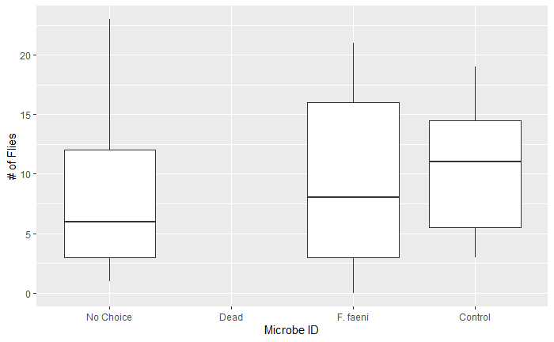
UF REPELLENT VS. CONTROL

Slide 14
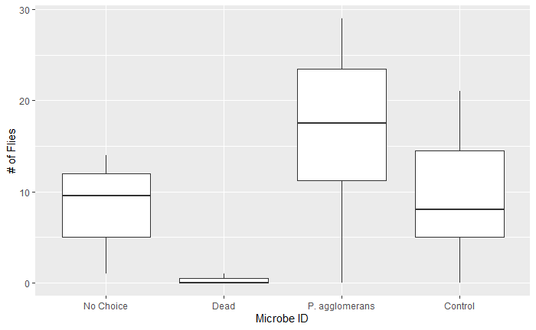
UF ATTRACTANT VS. CONTROL

Slide 15
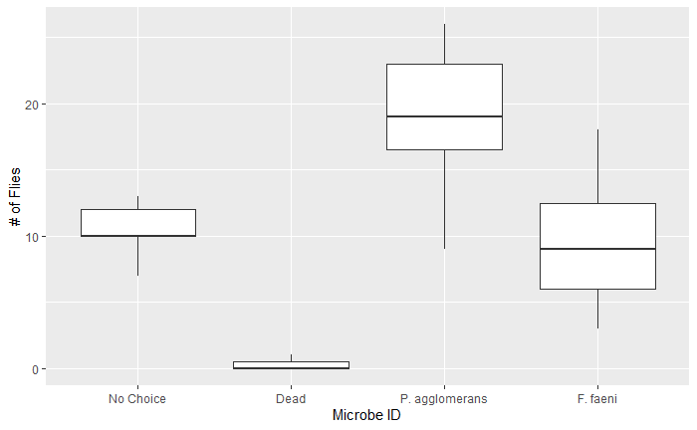
UF ATTRACTANT VS. REPELLENT

Slide 16
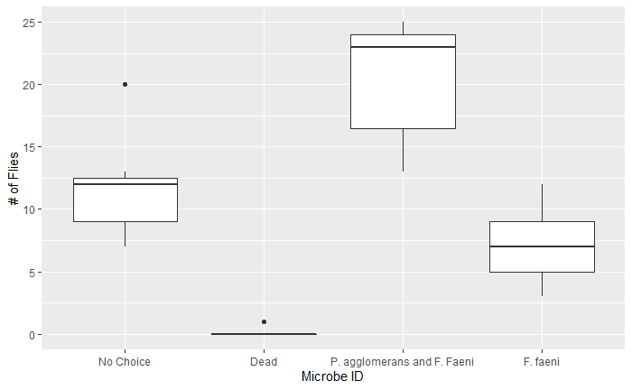
UF MIX VS. REPELLENT

Slide 17
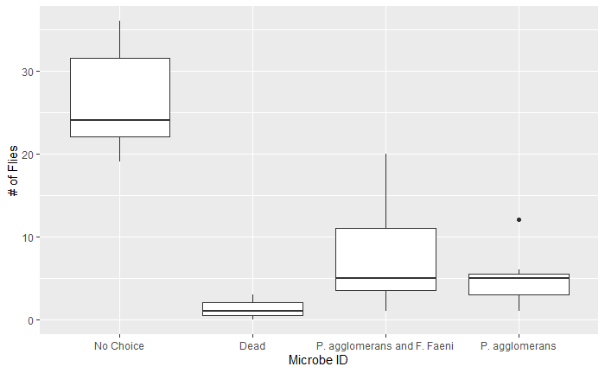
UF MIX VS. ATTRACTANT

Slide 18
Preliminary Assay
Environment: 22 C, 40% rH, 16L:8D photoperiod
40 flies per each chamber will be removed from food source ~20 hours prior to entering the treatment arenas and provided only water.
Microbes will be cultured 20 to 24 hours prior to inoculation.
Microbes will be inoculated into treatment at time zero.
Flies will be added to treatment arenas at time zero
Fly choice will be counted 2 hours, 24 hours, and 48 hours after time zero.

Slide 19
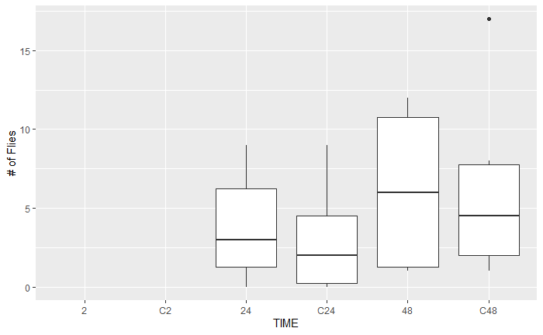
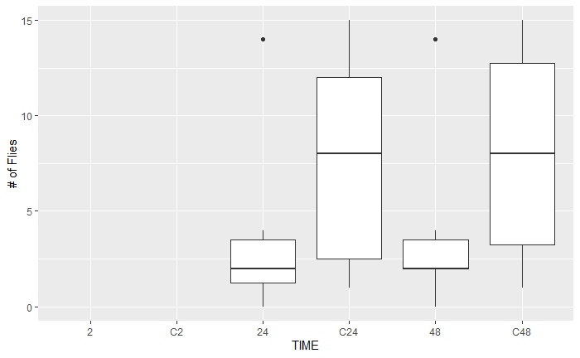
‘Feeding’ Flies and F. faeni VOCs
‘Starving’ Flies F. faeni VOCs
T
T
T
T
T
T

Slide 20
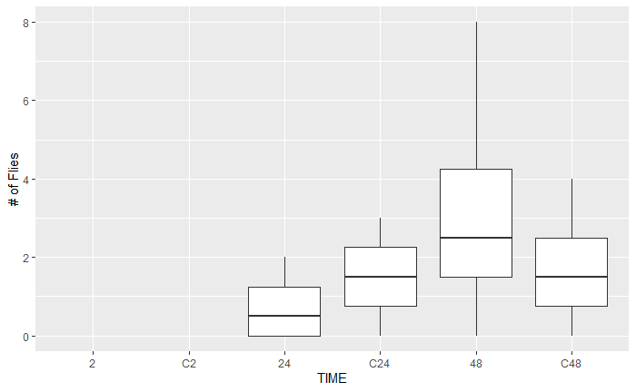

‘Feeding’ Flies and P. agglomerans VOCs
‘Starving’ Flies
P. agglomerans VOCs
Data Not Available
T
T
T

Slide 21
END

Slide 22
Experimental Weeks: 1, 2, & 3
SWD Choice: Microbe vs Control
Frigoribacterium faeni
Pantoe agglomerans
1x
5 Cages Total:
1 Control Cage
1 Control Jar: 10% Juice
1 Treatment Jar: 10% Juice + Microbe
NO Flies
Treatment Cages
1 Control Jar: 10% Juice
1 Treatment Jar: 10% Juice + Microbe
50 SWD flies
1x
5 Cages Total:
1 Control Cage
1 Control Jar: 10% Juice
1 Treatment Jar: 10% Juice + Microbe
NO Flies
Treatment Cages
1 Control Jar: 10% Juice
1 Treatment Jar: 10% Juice + Microbe
50 SWD flies
7x
7x

Slide 23
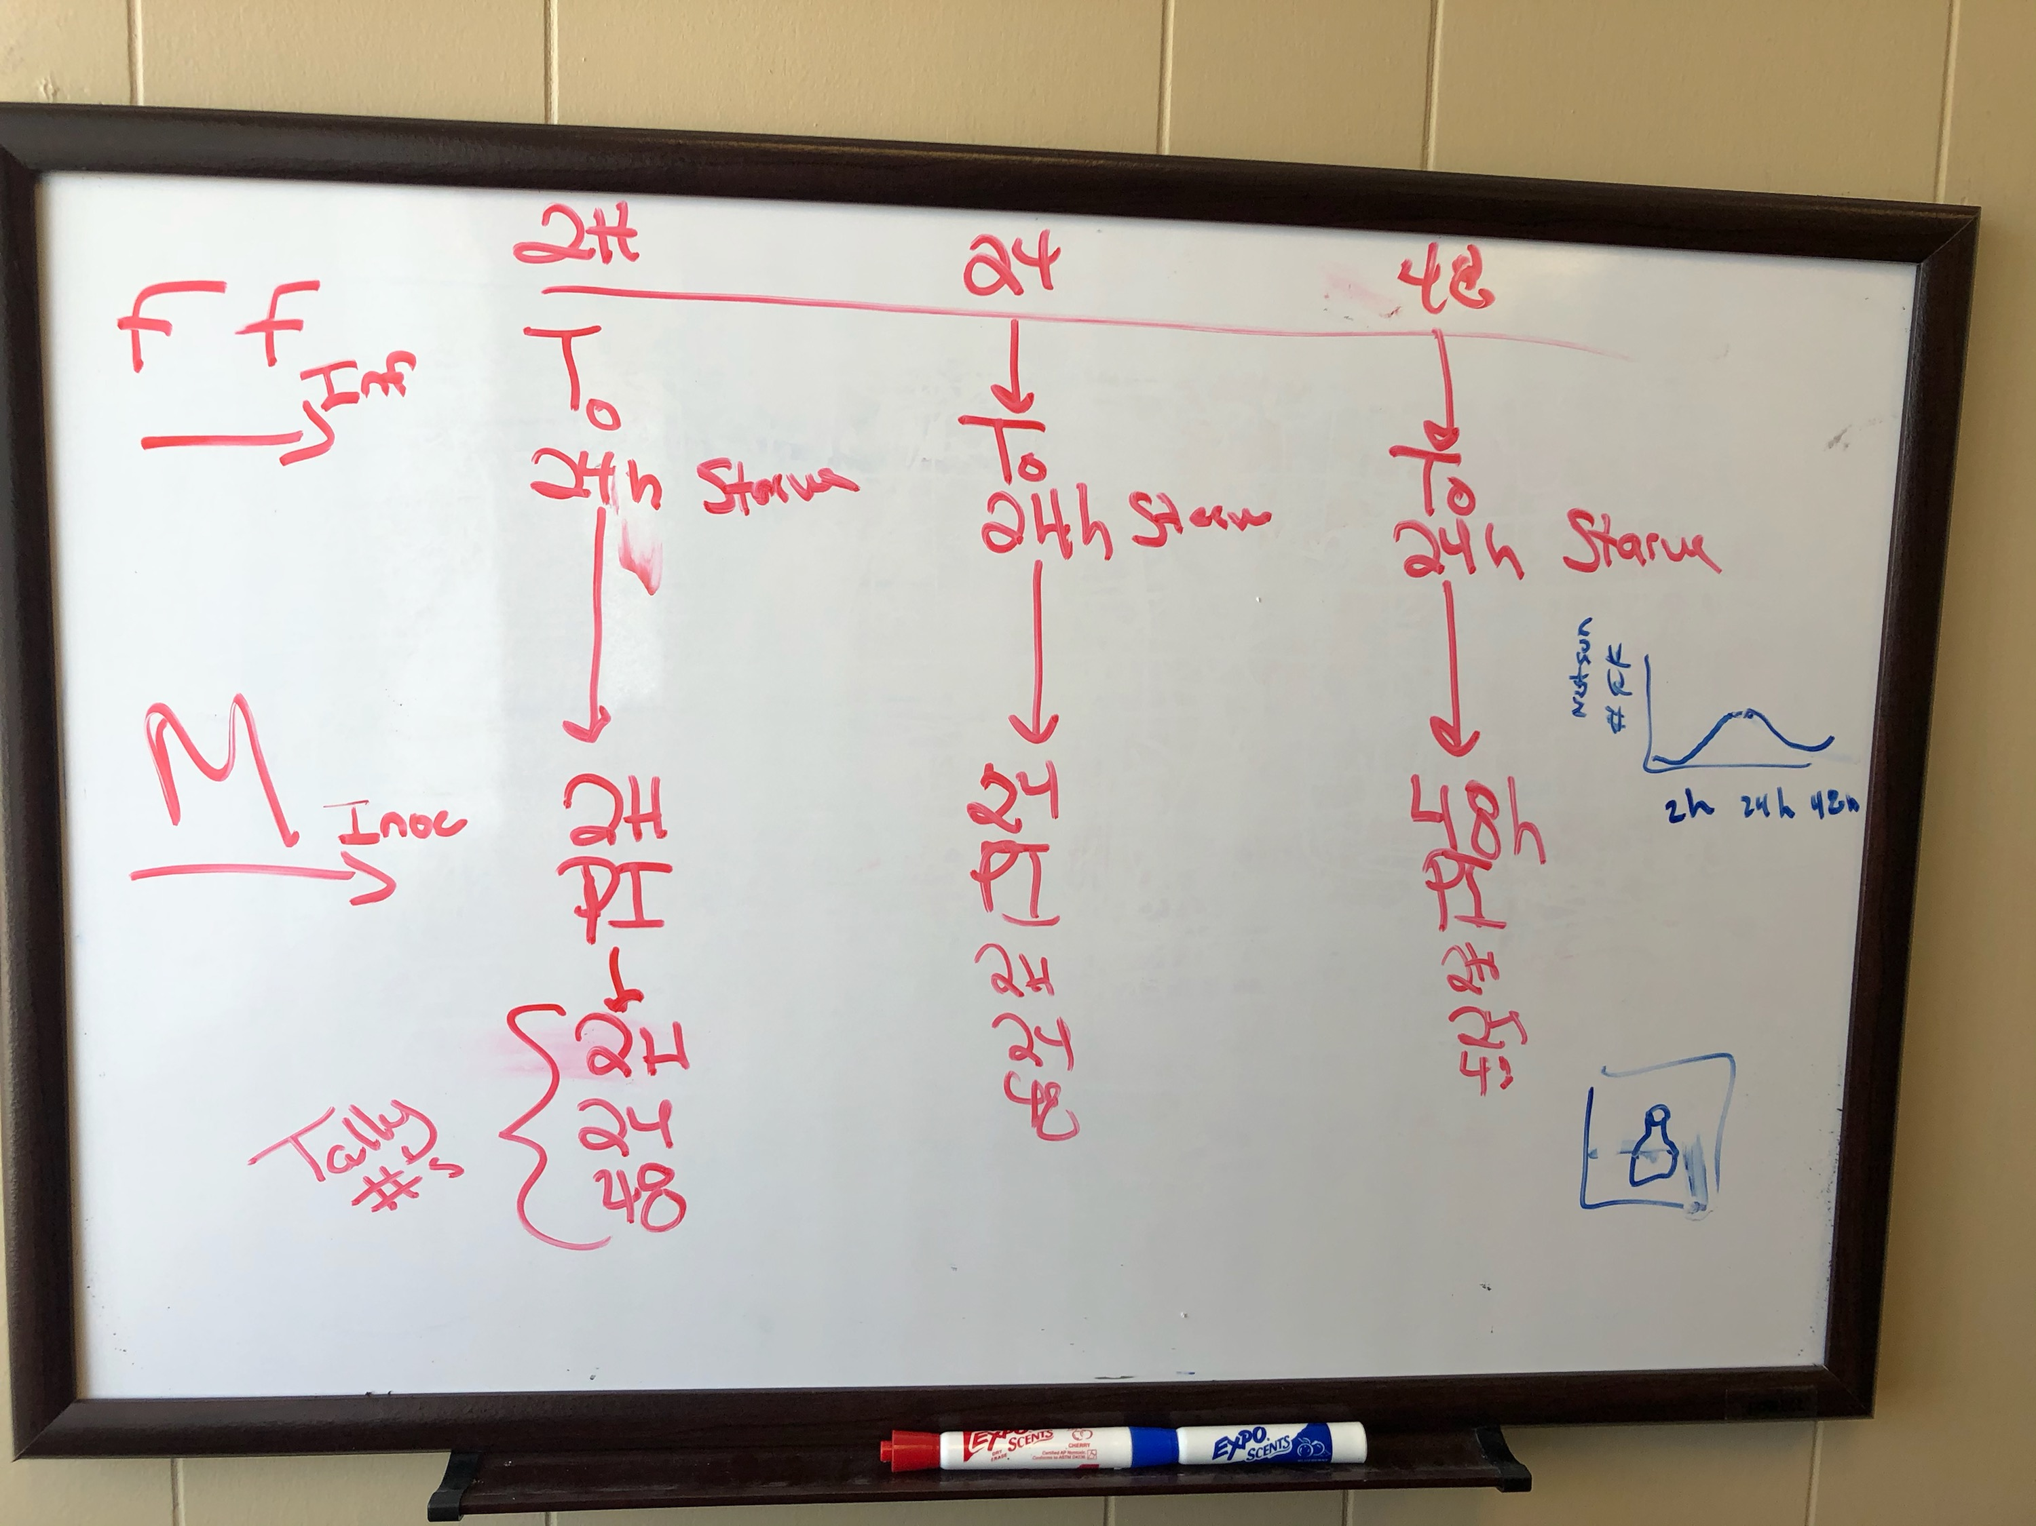
Meeting Notes about the prelim stuff
SWD:
Flies starved for 24 hours prior to exposure to VOC
Microbes inoculated into solution at time zero
Flies infused into cages with microbes as close to timepoints 0, 24, 48 hours
Fly behavior observed at 2, 24, 48 hours after infusion

Slide 24
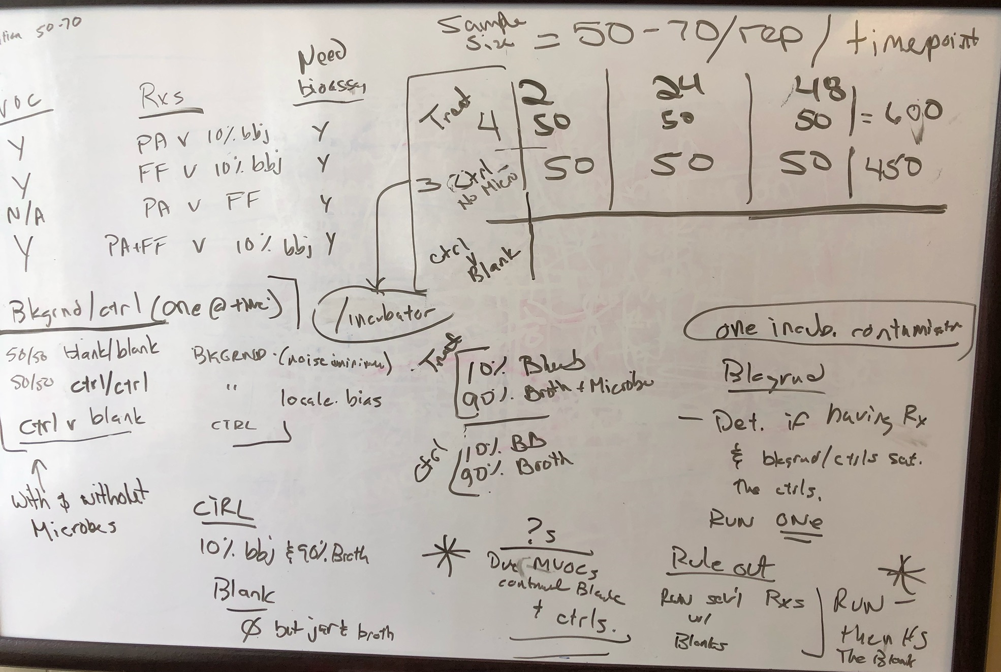

Slide 25
How will the environment effect the flies?
How do the SWD flies respond to an empty trap jar in the closed incubator environment? Flies exposed to 2 blank traps
How do the SWD flies respond to a control solution of blueberry juice and broth (blank, control) in the closed incubator environment? (contamination?) 2 mesh cages – 1 with blank + flies, 1 with control + no flies
Do the SWD flies prefer the control solution over an trap jar in the closed incubator environment? (1 mesh cage, blank v ctrl, and flies)
VS.
10% JUICE
90% BROTH

Slide 26
What happens when we add the microbes?
How do the SWD flies respond to an empty (blank) trap jar in the closed incubator environment with microbes producing VOCs?(silica absorption, 2 mesh)
How do the SWD flies respond to a control solution of blueberry juice and broth in the closed incubator environment with microbes producing VOCs? (same GC, diff cages)
Do the SWD flies prefer the control solution over an trap jar in the closed incubator environment with microbes producing VOCs? (1 mesh, choice)
Do the SWD flies prefer the control solution over a blank jar in the closed incubator environment with microbes producing VOCs? (similar to pg 150)
VS.
VS.
10% JUICE
90% BROTH

Slide 27
SWD Choice Bioassay: Blank vs. Control & Treatment vs. Control
Week 1: Blanks vs Control Samples in Incubator
24H: 2 Mesh cages with 2 blank traps (50 flies)
24H: 1 Mesh cages with 1 blank and 1 control trap (50 flies)
24H: VOC from each trap
This addresses 10% bbjb contaminate blank jar between 1 mesh and cages
Week 2: Treatment vs Control Sample in Incubator
2H: 2 Mesh cages with 1 treatment and 1 control trap (50 flies)
2H: 1 Mesh cages with 1 treatment and 1 blank trap (50 flies)
2H: VOC from each trap
24H: 2 Mesh cages with 1 treatment and 1 control trap (50 flies)
24H: 1 Mesh cages with 1 treatment and 1 blank trap (50 flies)
24H: VOC from each trap
48H: 2 Mesh cages with 1 treatment and 1 control trap (50 flies)
48H: 1 Mesh cages with 1 treatment and 1 blank trap (50 flies)
48H: VOC from each trap

Slide 28
SWD Choice Bioassay: Microbe vs. Microbe
Week 5: F. faeni and P. agglormeans vs SWD
2H: 5 Mesh cages with 1 treatment and 1 control trap (50 flies)
2H: 2 Mesh cages with 1 control and 1 blank trap (50 flies)
2H: VOC from each trap
24H: 5 Mesh cages with 1 treatment and 1 control trap (50 flies)
24H: 2 Mesh cages with 1 control and 1 blank trap (50 flies)
24H: VOC from each trap
48H: 5 Mesh cages with 1 treatment and 1 control trap (50 flies)
48H: 2Mesh cages with 1 control and 1 blank trap (50 flies)
48H: VOC from each trap
Mix v ctrl?

Slide 29
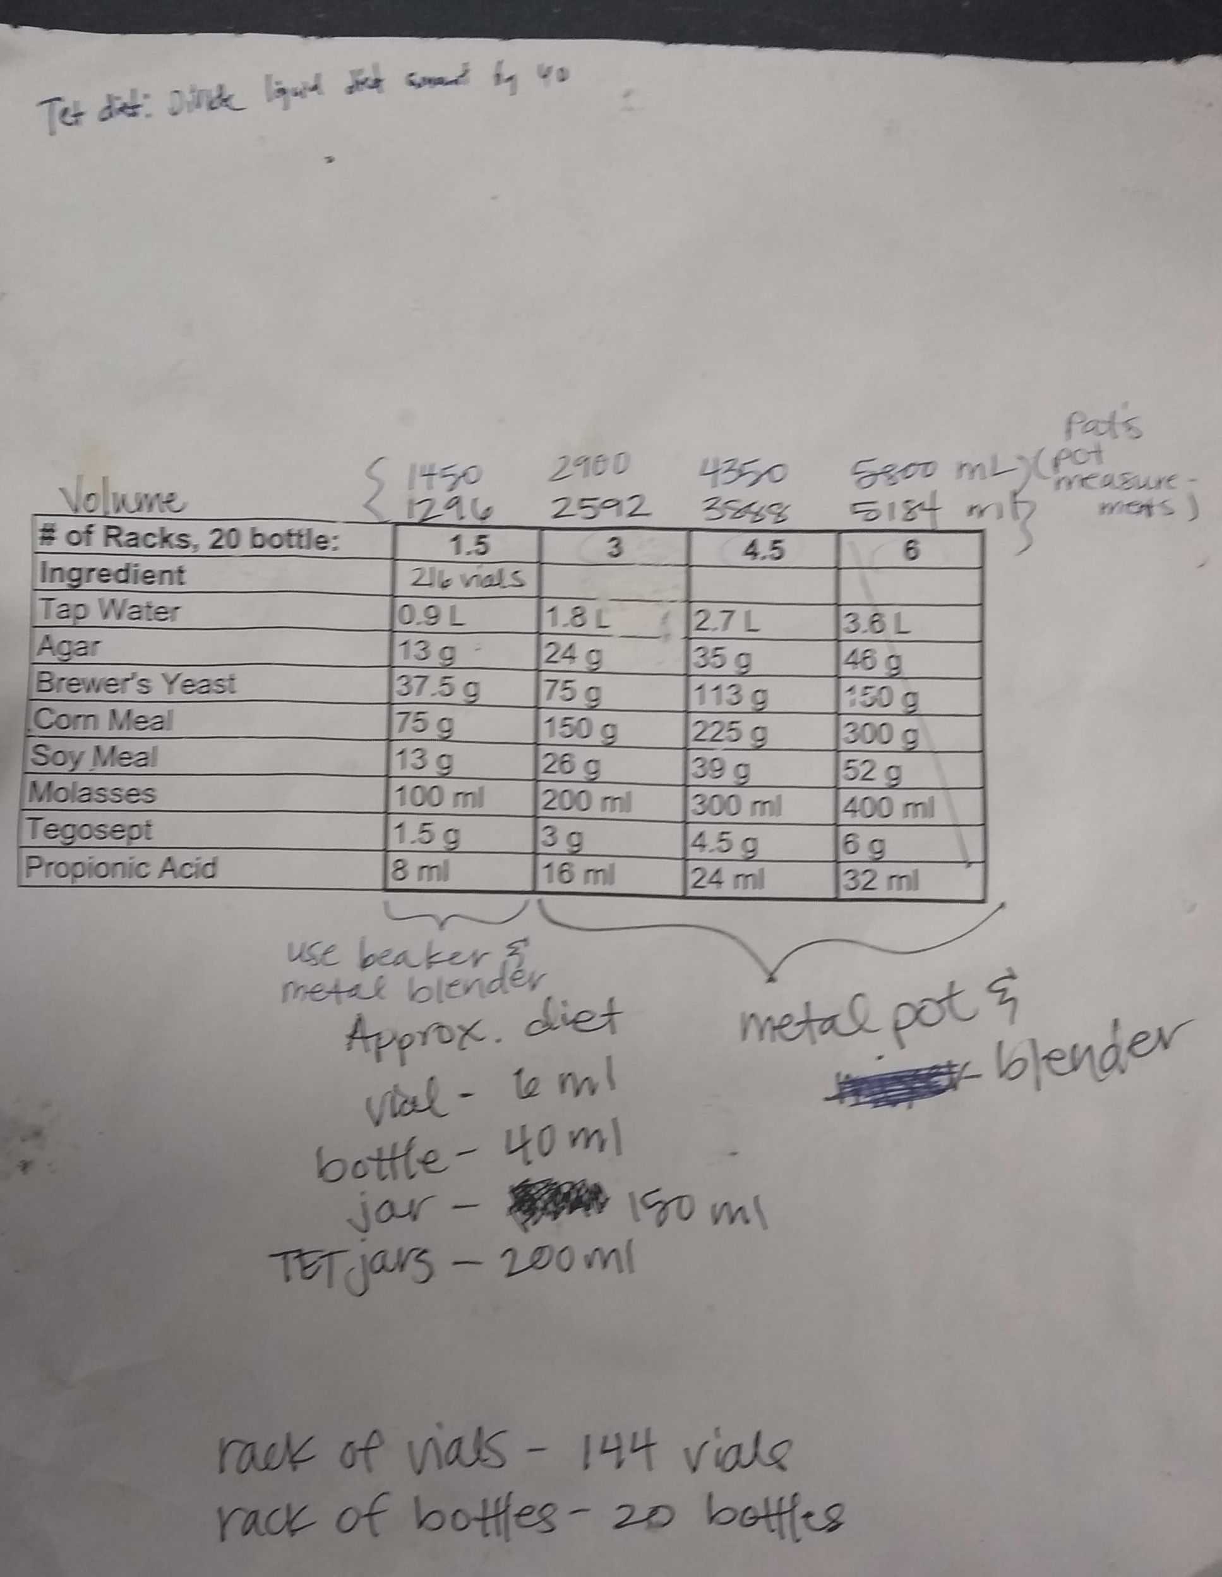

Slide 30
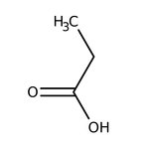
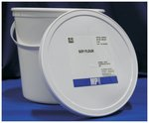
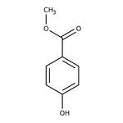
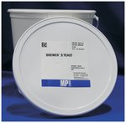

Purchase Items
Propionic Acid, BAKER™, J.T.Baker™ Quantity: 500mL, Packaging: Narrow Mouth Amber Glass Bottle
by J.T.Baker U33007 Catalog number 02-003-884
Soy Flour Quantity: 2260g
by MP Biomedicals™ 0296002405 Catalog number ICN96002405
Methyl 4-hydroxybenzoate, 99% Quantity: 250g
by Alfa Aesar™ A1428930 Catalog number AAA1428930
Brewers Yeast Quantity: 2260g
by MP Biomedicals™ 0290331205 Catalog number ICN90331205
PLUG, DROSOPHILA, FOAM
by Chemglass Life Sciences CGE4790005 Catalog number 50-189-7638
Fly bottle, square bottom polypropylene, 6 oz, 500/case
by Thomas Scientific 1158J85 Catalog number 50-146-1849

Slide 31
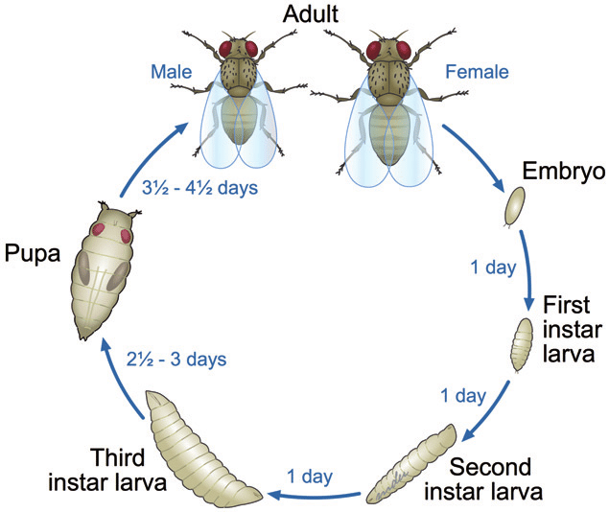
Life Cycle
Stage | Length (days)
Adult | 5
1st instar: | 1
2nd instar: | 1
3rd instar: | 2.5
Wandering: | 0.5
Pupa: | 5

Slide 32
Monthly Schedule
Monday | Tuesday | Wednesday | Thursday | Friday | Saturday | Sunday
 | Embryo (1) | Embryo (2) | Embryo (3)
 | Embryo (1) | Embryo (2) | Embryo (3) |  |  | Adult (1)
Adult (2) Starve (1) | Adult (3) Starve (2) 2H assay (1) | Starve (3) 24H assay (2) | 48H assay (3) |  |  | Adult (1)
Adult (2) Starve (1) | Adult (3) Starve (2) 2H assay (1) | Starve (3) 24H assay (2) | 48H assay (3)

